Slide 1
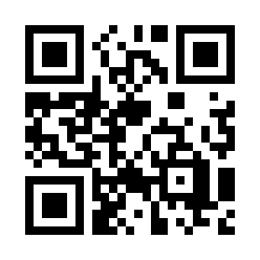

Problem Solving Quiz
https://bit.ly/3m9BRXC

